Slide 1
Storybook Mode 3 Rough Draft #1.1
The Bard from Racha Den DEMO
8 September 2023

Slide 2
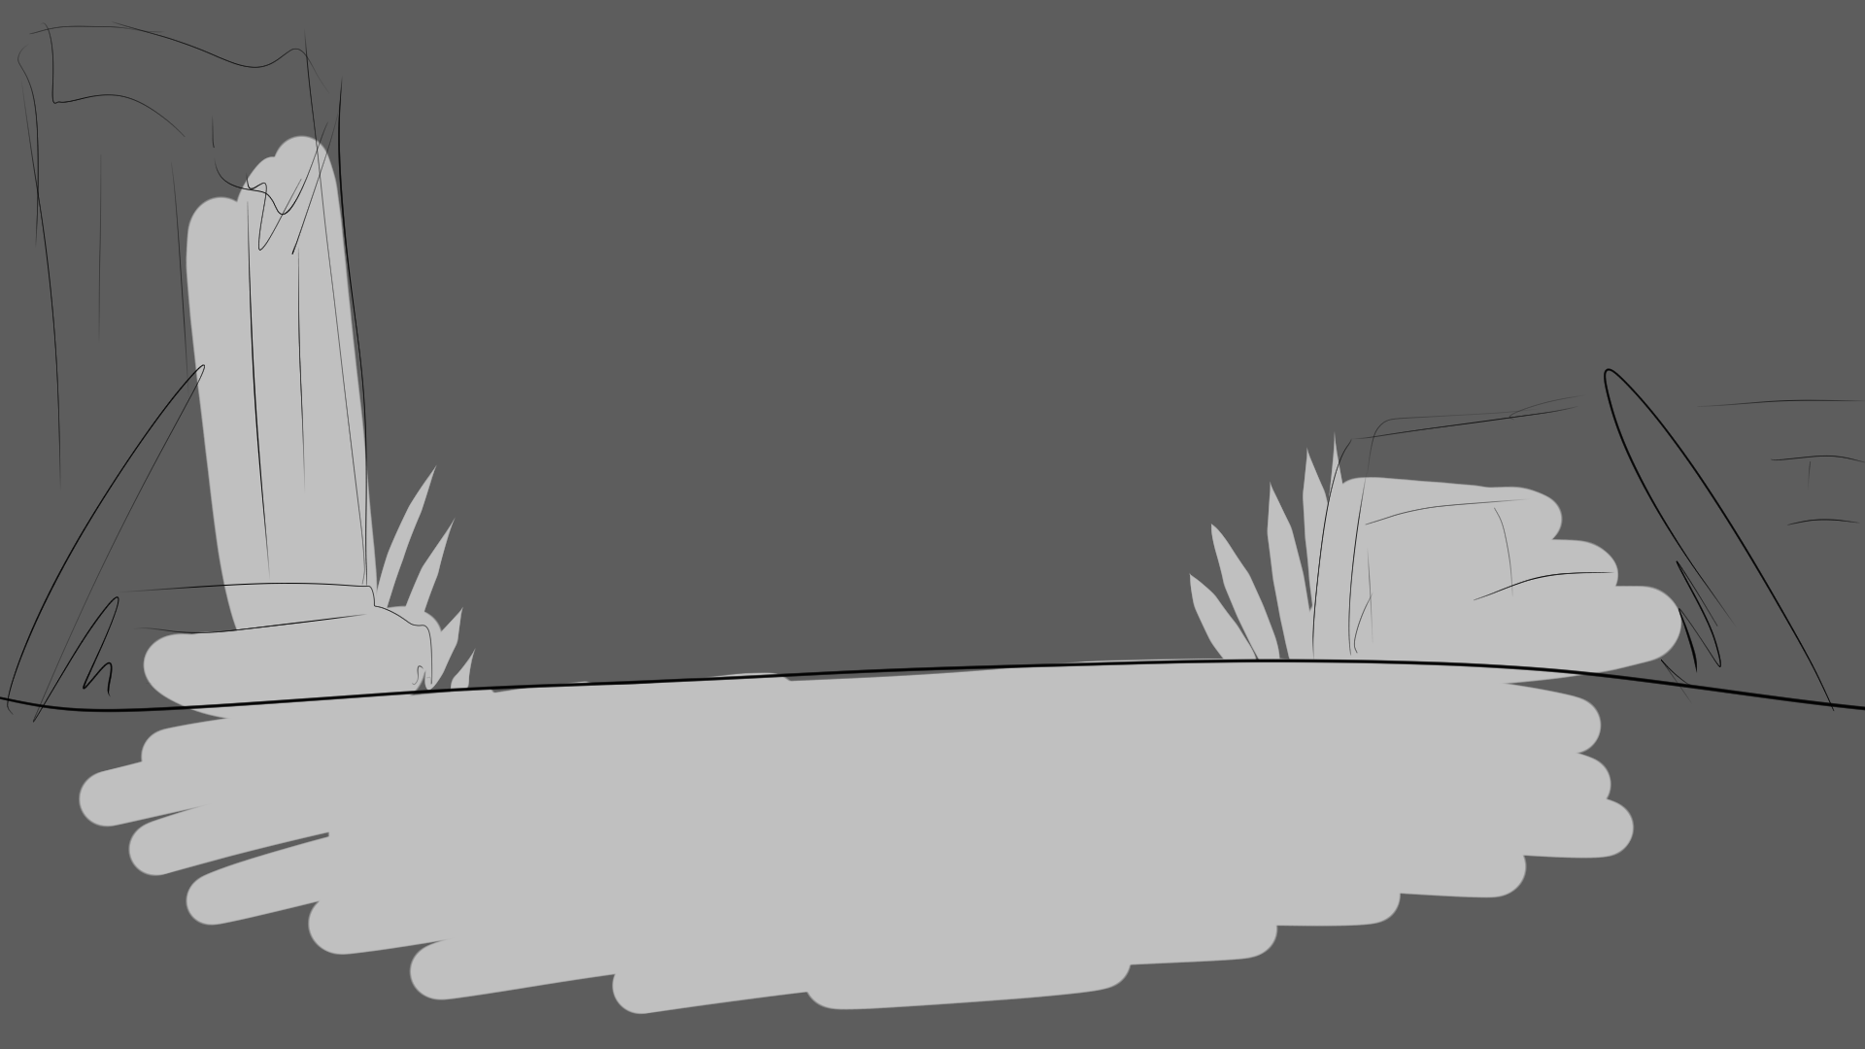

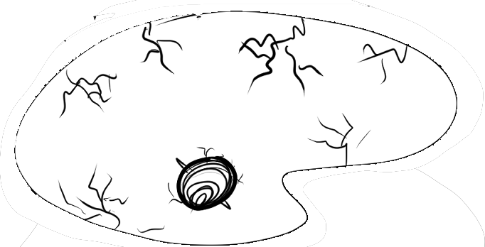

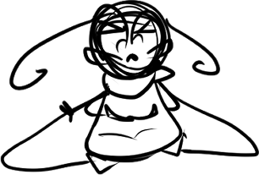
Suddenly, she sensed an evil magic—yellow magic.
Deanna pondered at the Aesop’s tale.
Notes:
SHOW “bg stbk3_page 1” and “stb3_page 1_deanna 1” / SHOW text box 1 / FADE IN “stb3_page 1_darkened” / ANIMATE “stb3_page 1_deanna 1” to “deanna 2” / SHOW text box 2 / FADE IN “stb3_page 1_smeared mask” / ANIMATE “smeared mask” down slowly.

Slide 3
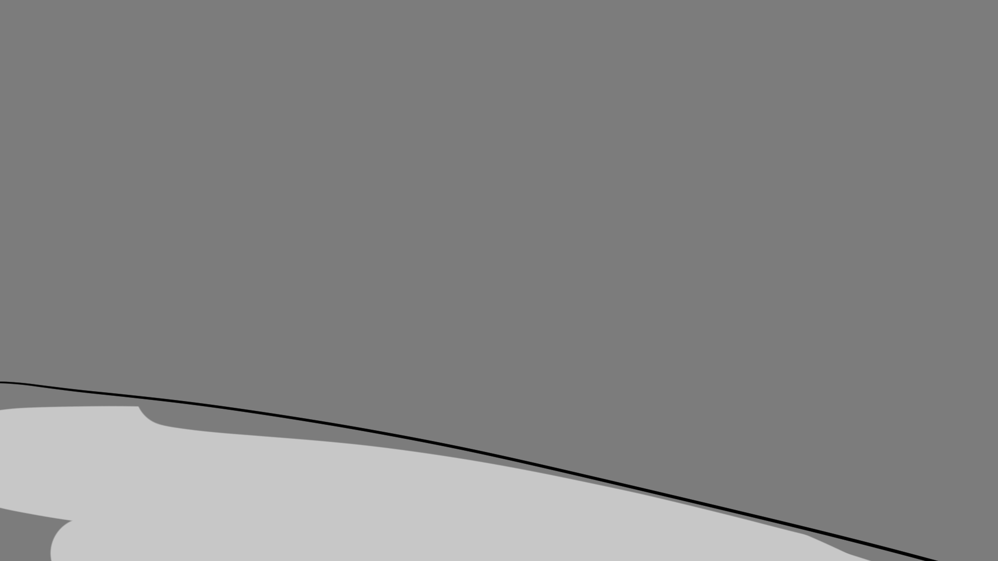
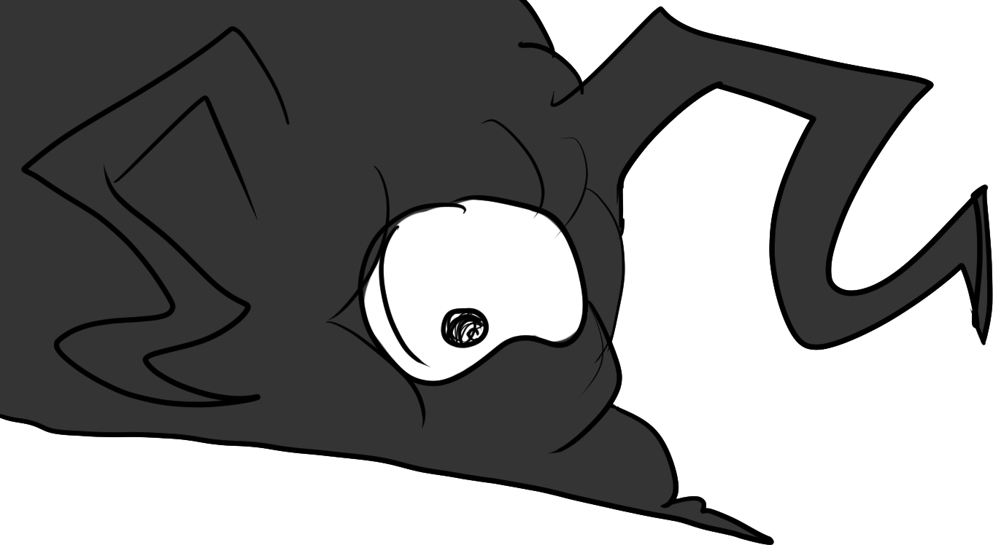
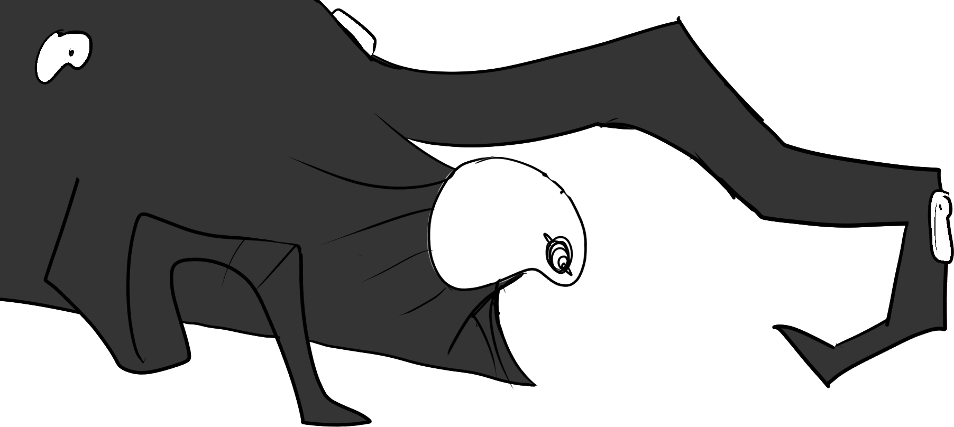
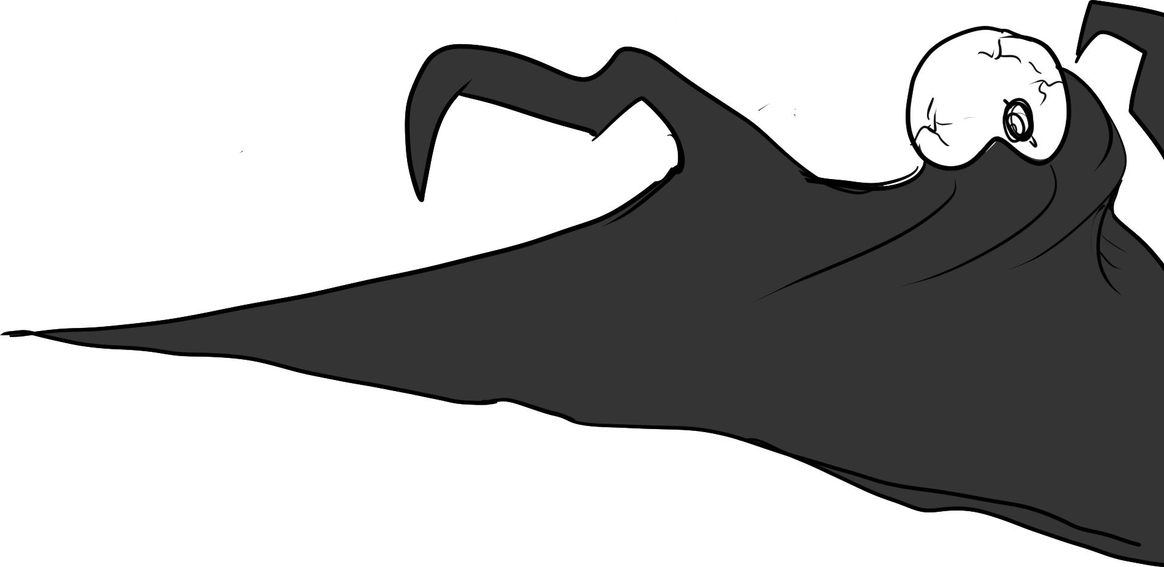
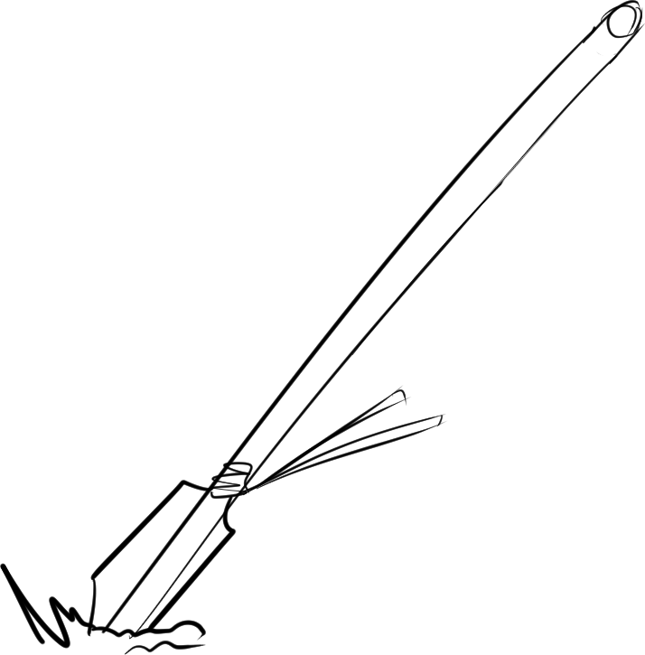
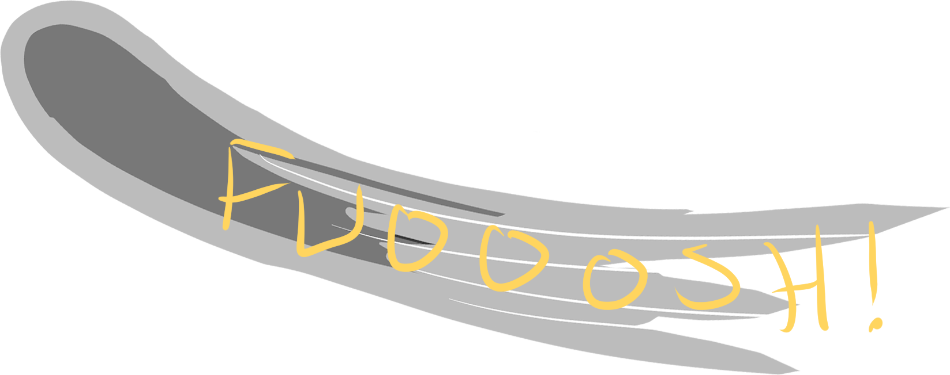
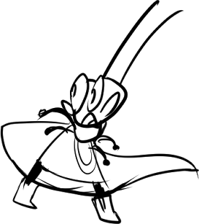
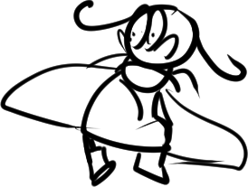
It was the Smeared, the Ancients’ sworn enemies! Its glitched roar echoed throughout the forests. Deanna screamed for her life! When suddenly—
The Smeared recoiled from the sudden spear. A blur then swooped by, scooping Deanna up in great speeds, much to the Smeared’s ire.
Notes:
SHOW “bg stb3_page 2” with “stb3_page 2_deanna 1” and “stb3_page 2_smeared 1” / Show text 1 / FADE IN “stb3_page 2_spear” / FADE IN “stb3_page 2_deanna 2” and “smeared 2” / WIPE FROM RIGHT “stb3_page 2_blur swipe” and WIPE OUT / FADE IN “stb3_page 2_smeared 3” / SHOW text.

Slide 4
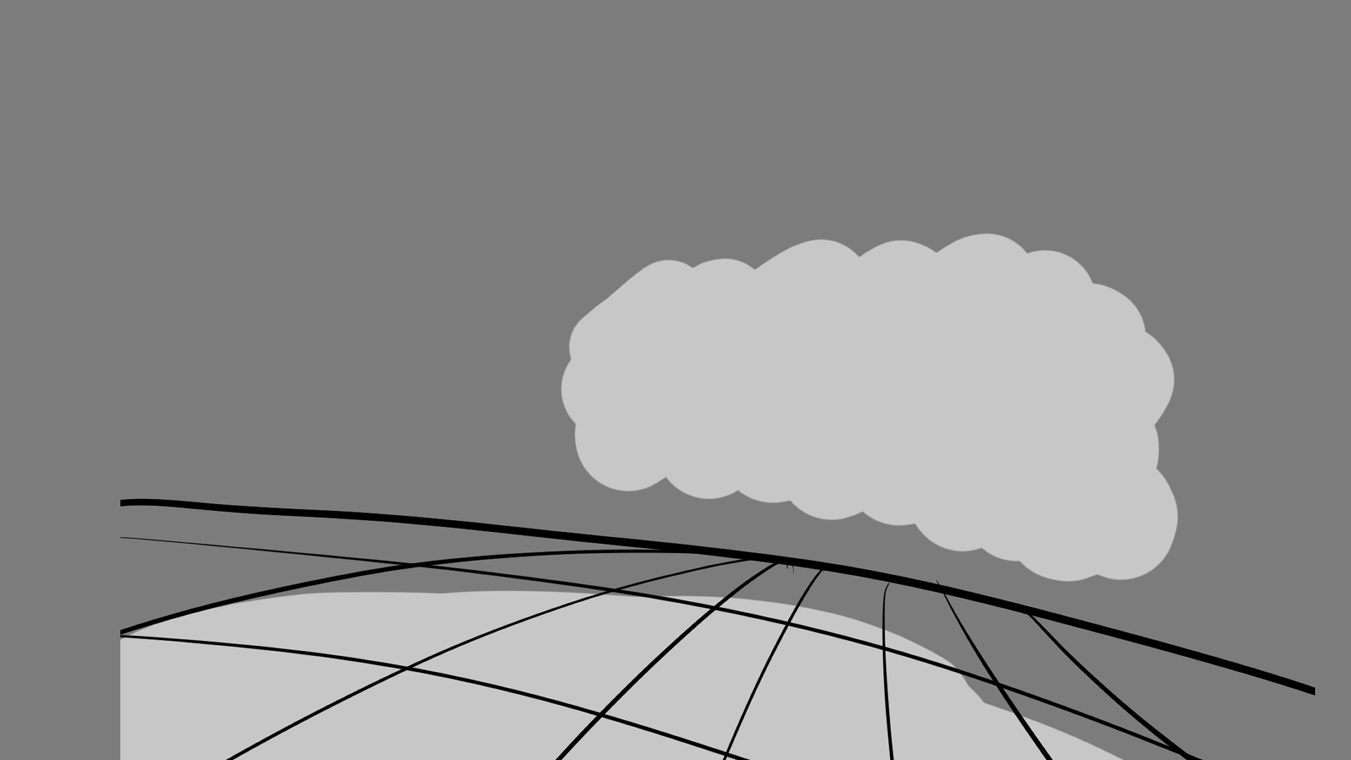
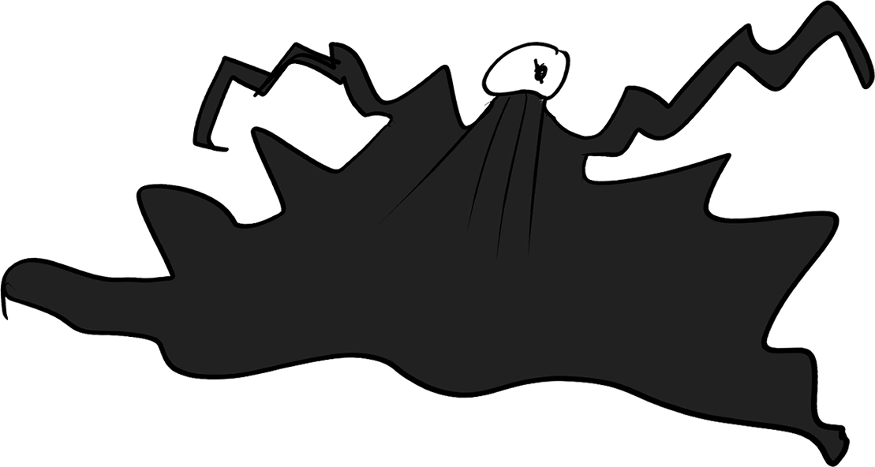
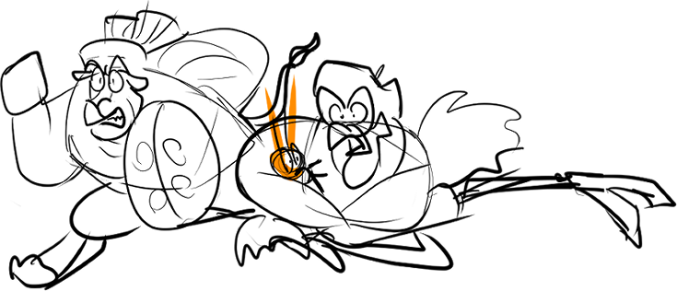
Deanna
Lethabo
Athos
As they ran, the Smeared monster grates out a horrific, ear-piercing roar that shook even the leaves themselves.
“How did that demon find us so quickly?!”
“No matter! We must head for sunlight. They can’t stand it!”
“It must have sensed my magic. I’m so sorry!”
Athos held dear to Deanna as he and Lethabo hightailed out of there.
Notes:
SHOW “bg stb3_page3” WITH “stb3_page 3_athos lethabo and deanna” AND “stb3_page 3_smeared” / SHOW TEXT.

Slide 5
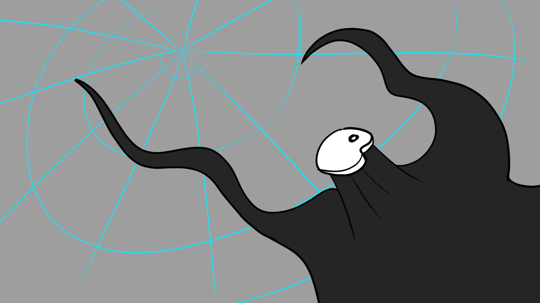

The Smeared unleashed a miasmic magic that rumbled like an angry thunder cloud. The cloud aimed for the ruins and surrounding wood...
The Smeared didn’t budge. Instead, it reached out its tendrils and began to glow with an eerie yellow haze.
Notes:
SHOW “bg stb3_page 4” / SHOW TEXT 1 / FADE IN “stb3_page 4_yellow magic” / SHOW TEXT.

Slide 6
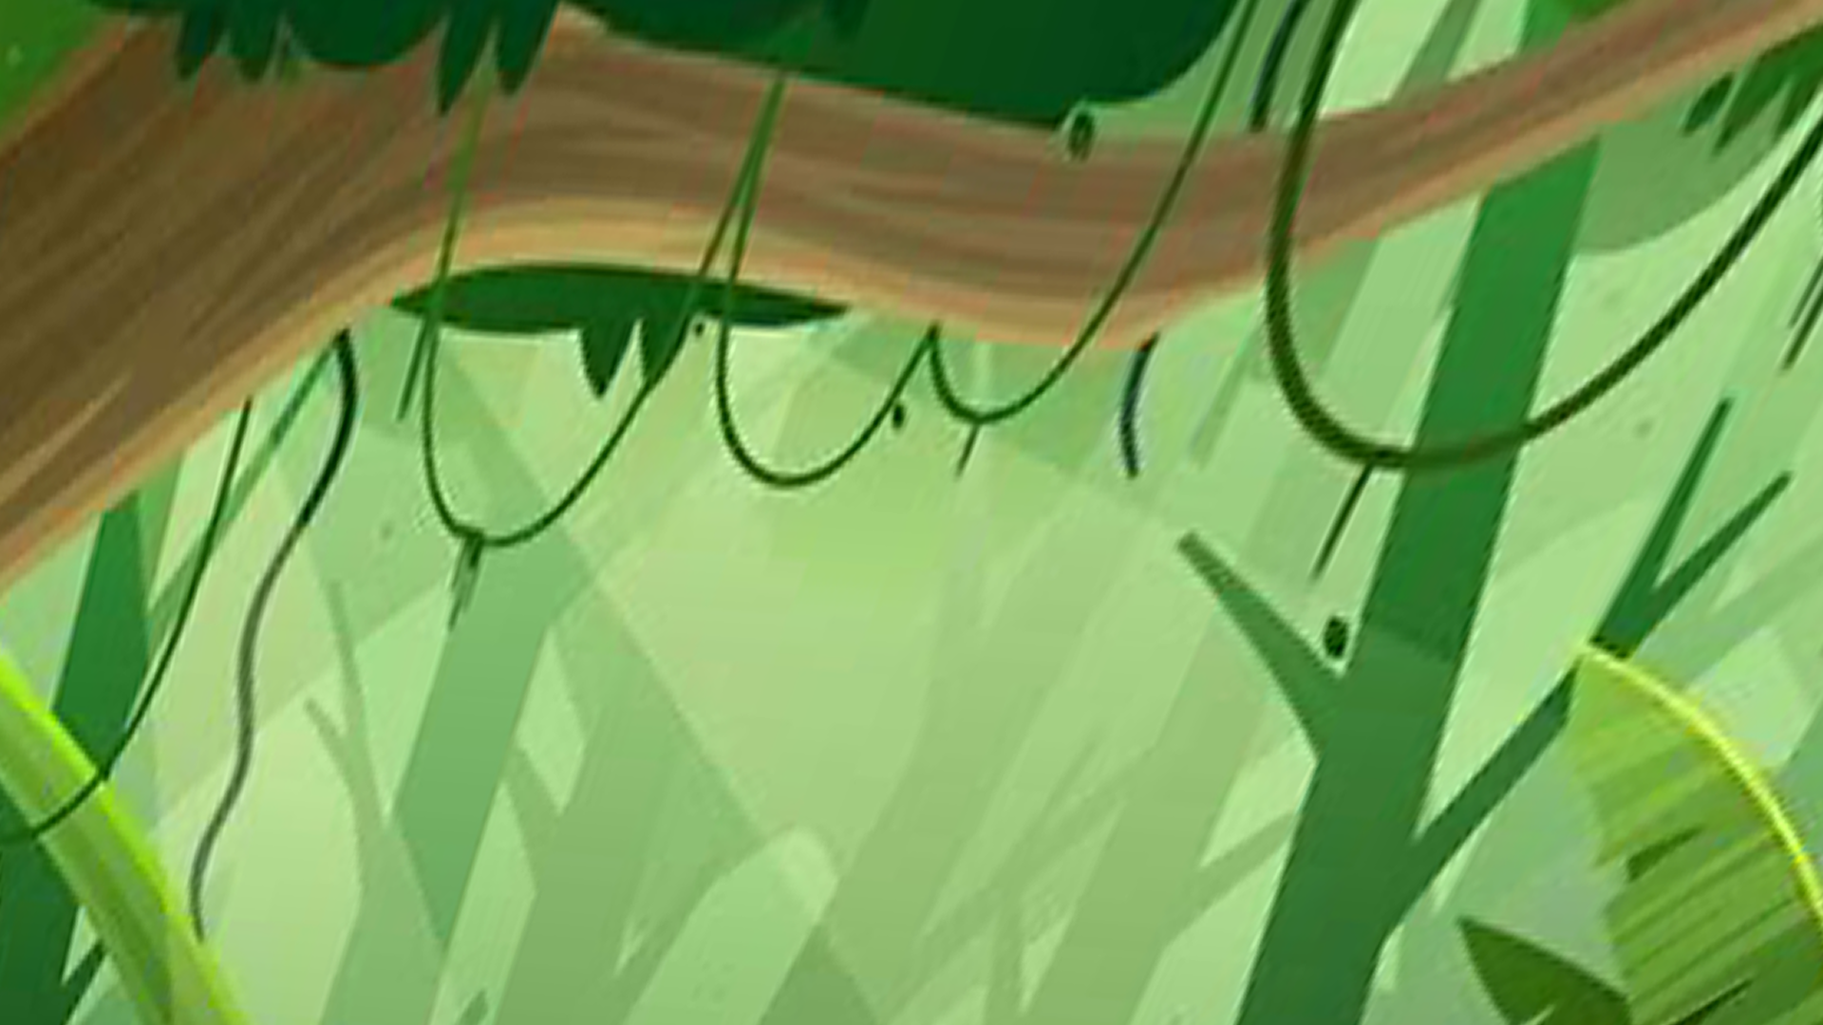
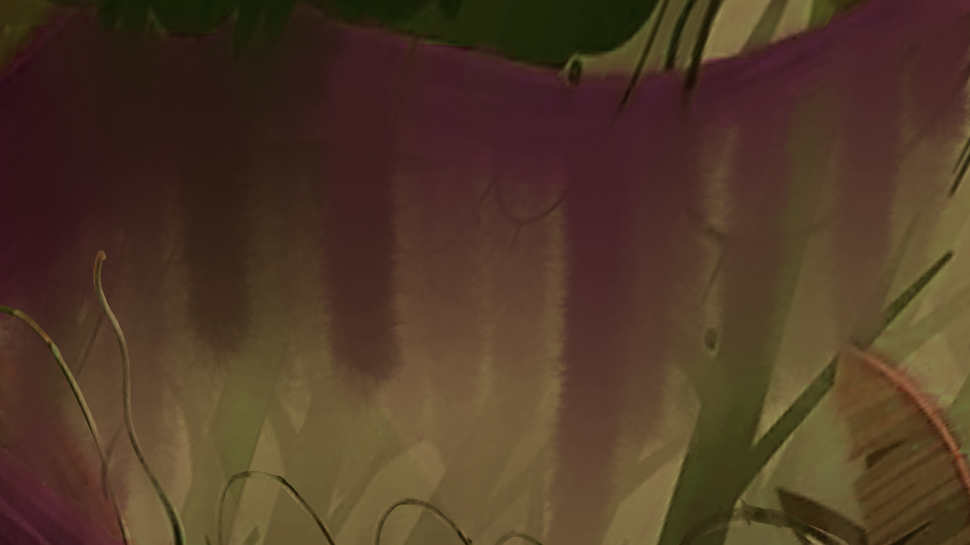
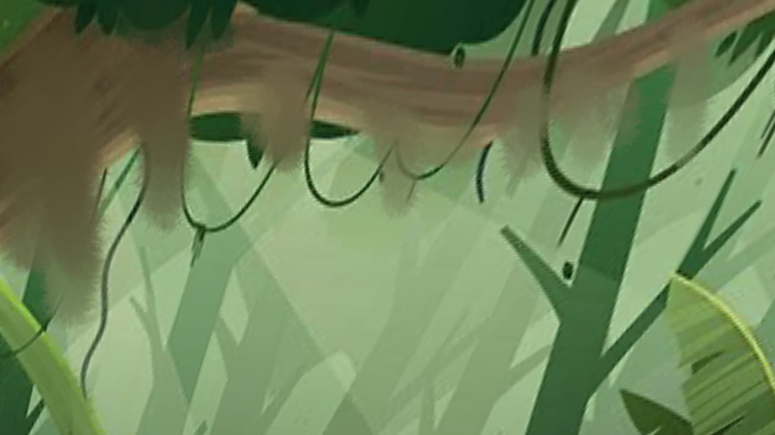
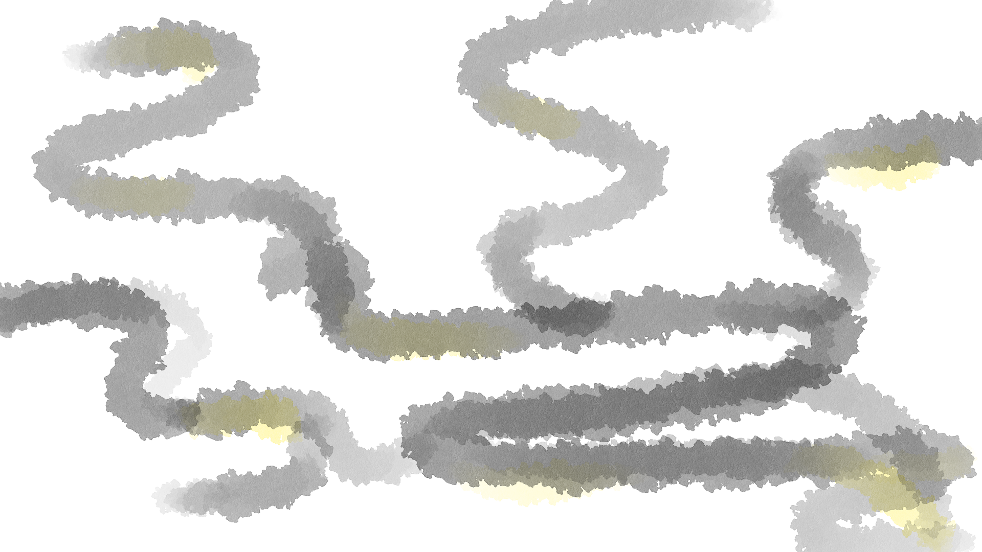
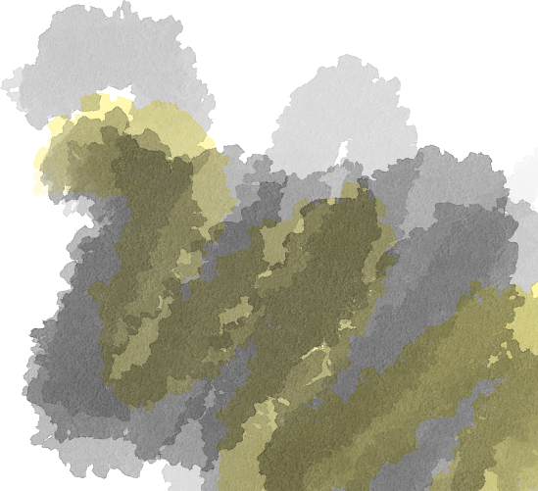
The yellow magic blurred reality in its wake. The trees, the ground, and even the sky began to bleed like runny paint. Some parts oozed up while other parts oozed down.
The cloud circled around the forest, seemingly more interested in the terrain than Deanna and her friends. However, the moment it touched the branches…
Notes:
SHOW “bg stb3_page 5” then FADE IN “stb3_page 5_smog 1” / SHOW TEXT / ANIMATE “stb3_page 5_smog 2” then FADE IN “stb3_page 5_melting jungle 1” then “melting jungle 2” / SHOW TEXT.

Slide 7

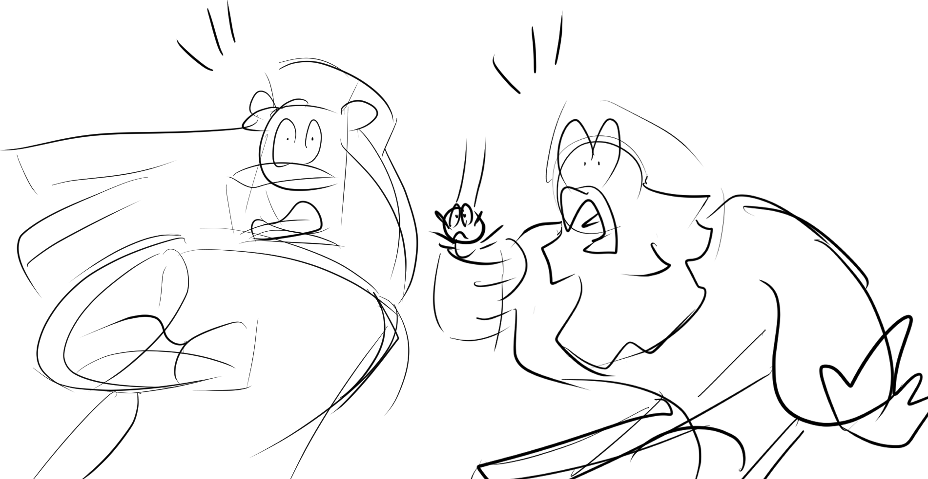
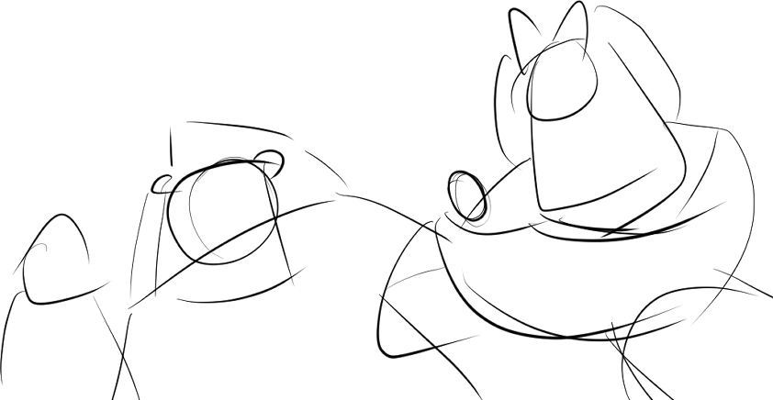
Deanna, Lethabo, and Athos stopped in their tracks, speechless at the sight before them!
Notes:
SHOW “bg stb3_page 6” / ANIMATE “stb3_page 6_characters running 1” TO “characters running 2” / SHOW TEXT.

Slide 8
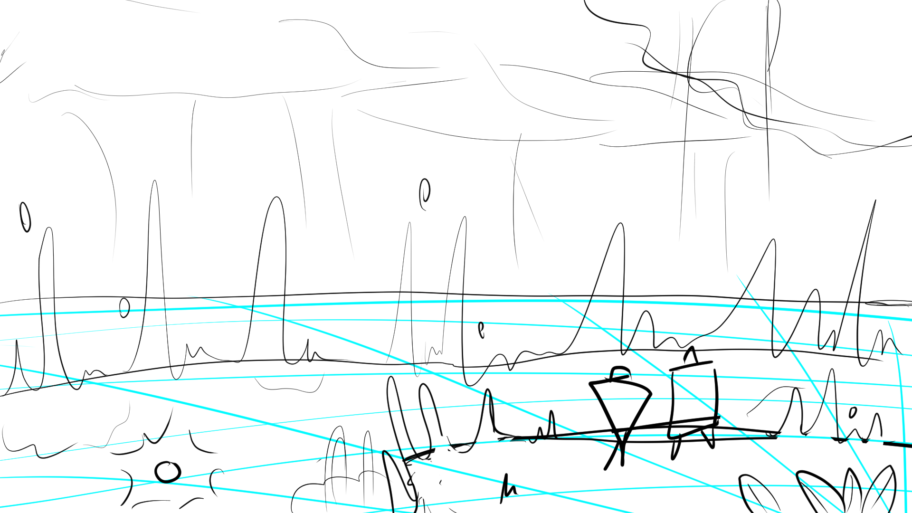
The path before them had turned upside-down! The floor was no longer solid with dirt and rocks, but instead opened to the sky below!
Jumping in would either mean they fall down into the sky or fall up into the ground high up above with a kur-splat! They wouldn’t dare test it.
Notes:
SHOW “bg stb3_page 7” / SHOW TEXT.

Slide 9
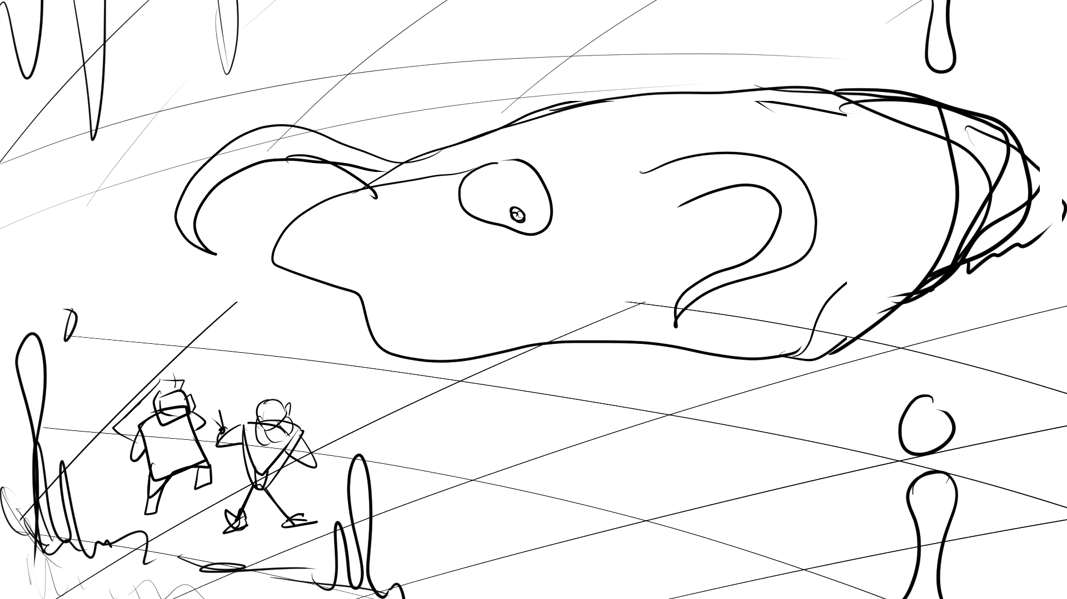
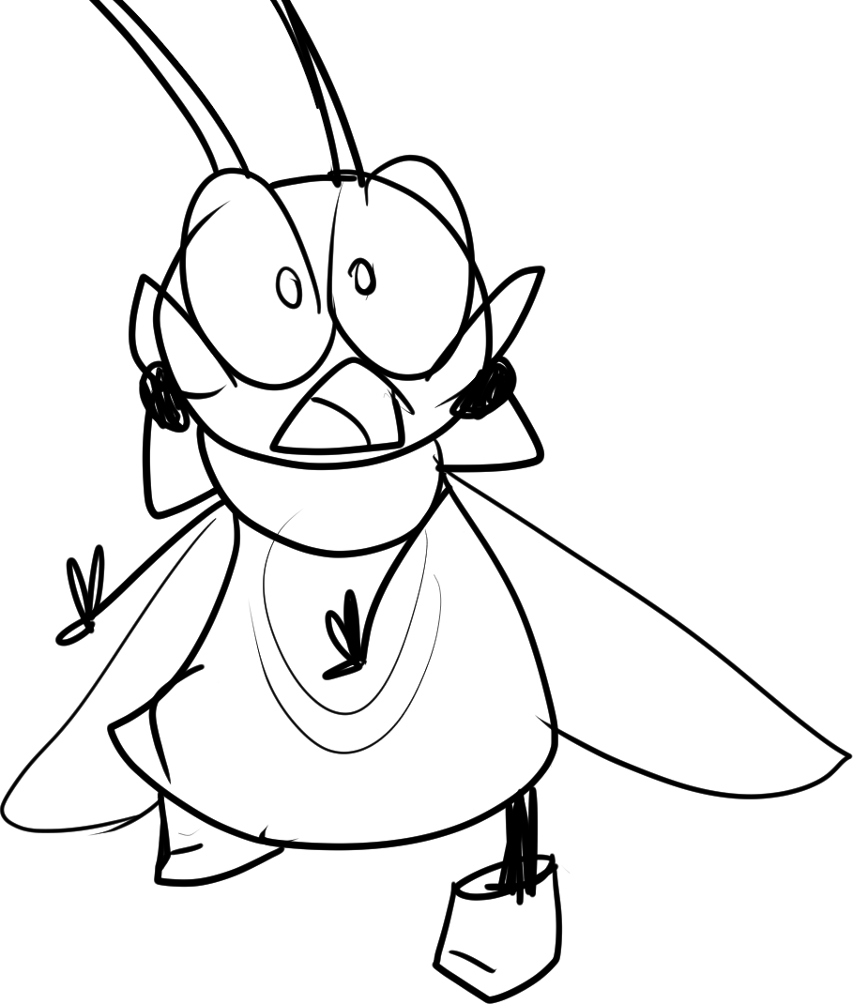
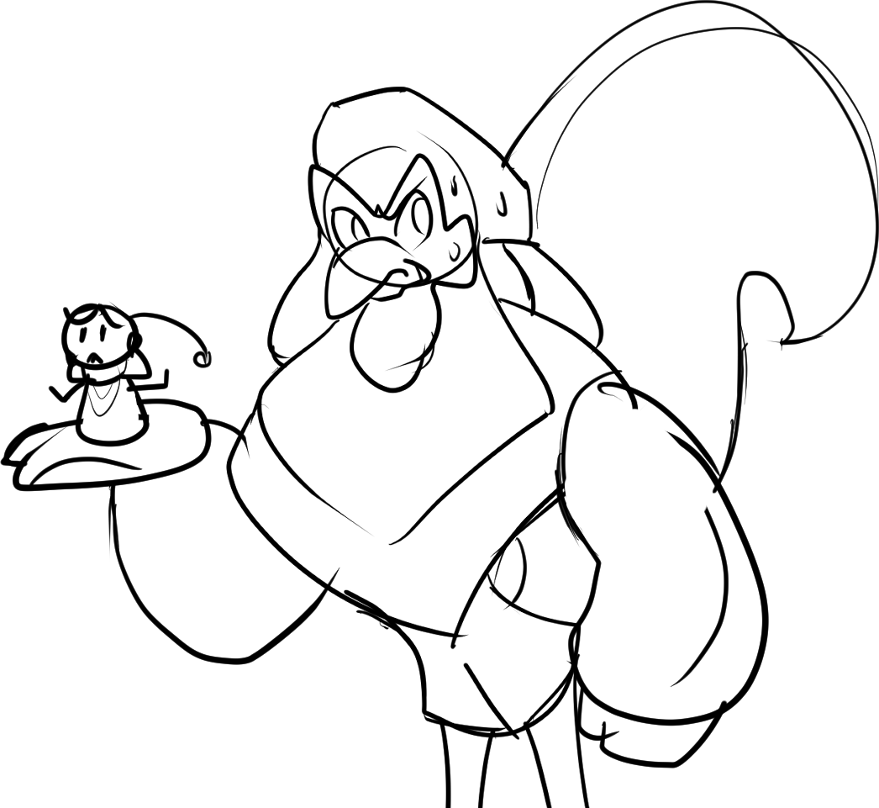
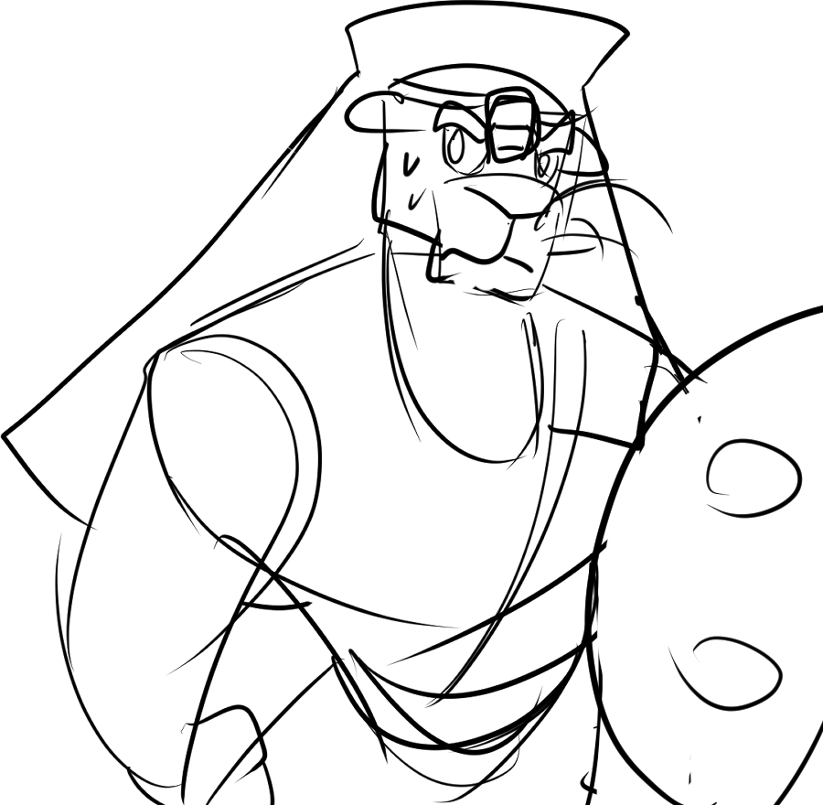
Deanna
Deanna and friends spun around. The Smeared burbled and gurgled right for them! They were cornered!
Lethabo and Athos shared looks. There is one thing they can do… for Deanna.
“We’re gonna get eaten! What should we do?!”

Slide 10
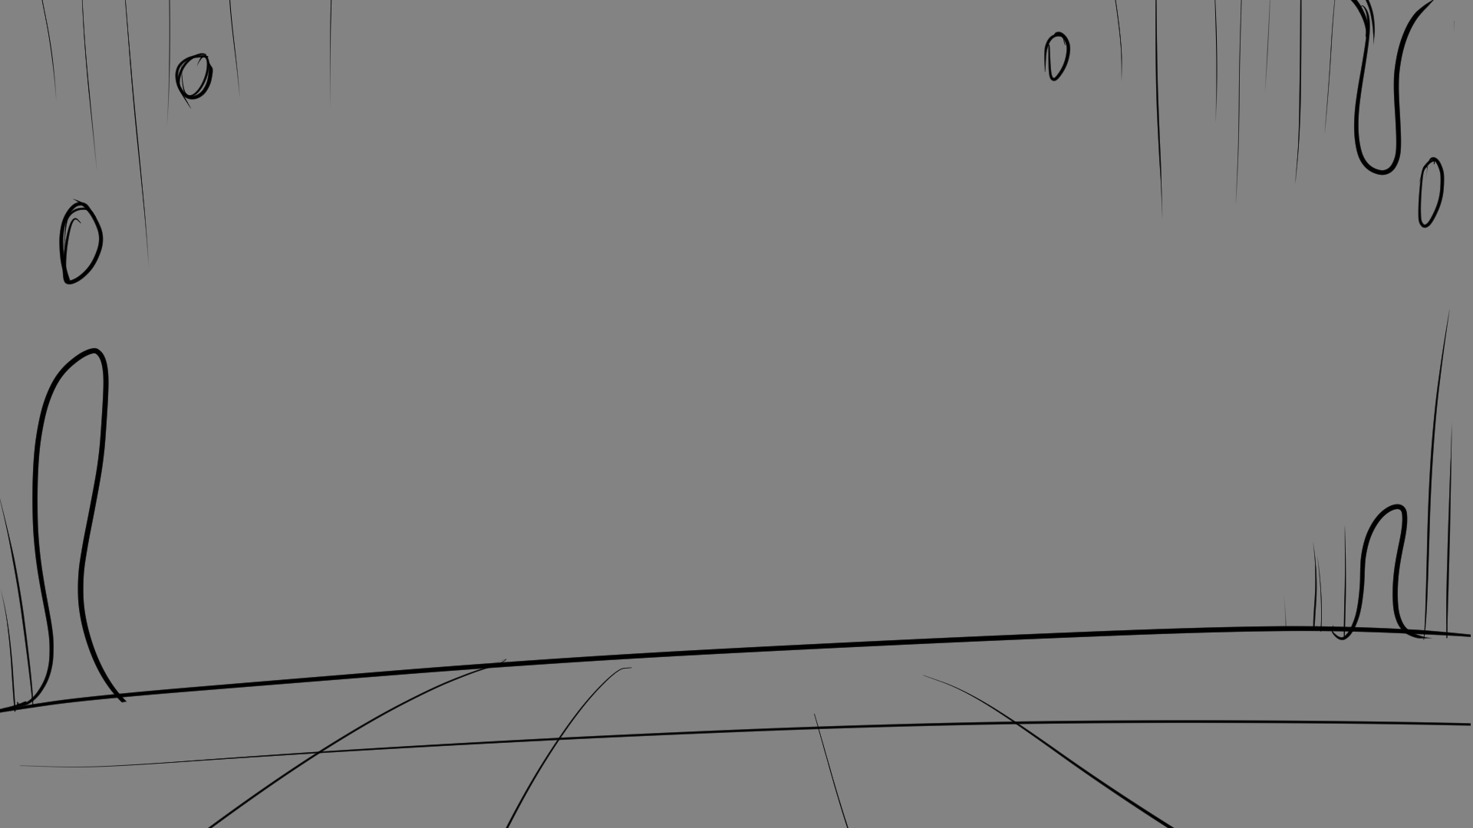
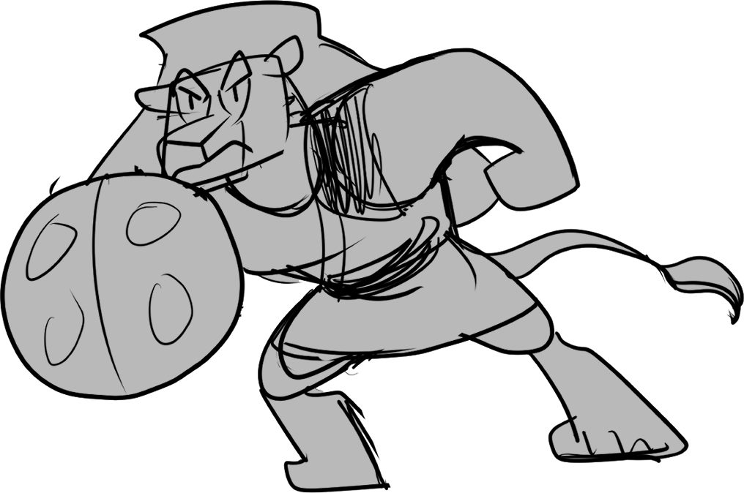
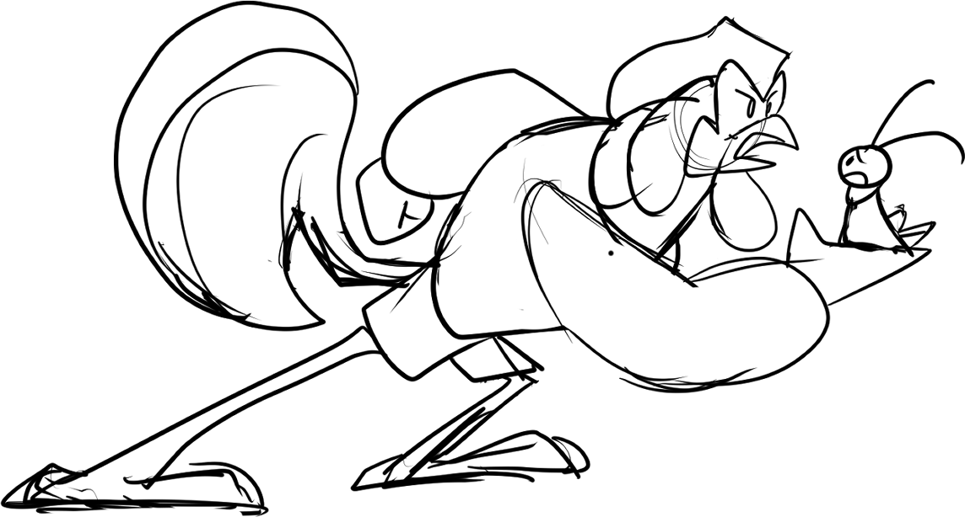
Athos
Deanna
Lethabo went on the defensive with his ladybug shield as Athos edged backwards towards the cursed chasm.
“Deanna, you can fly. Get far away from here. We’ll distract it!””
“What?? I can’t leave you guys!”
Notes:
SHOW “bg stb3_page 9” / WIPE IN “stb3_page 9_Lethabo” and “Athos” / SHOW TEXT.

Slide 11
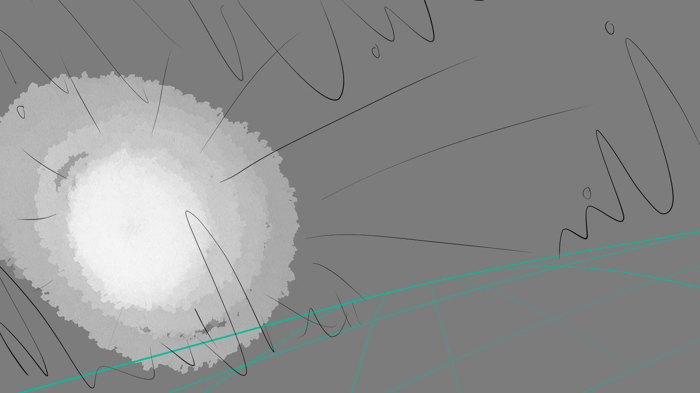
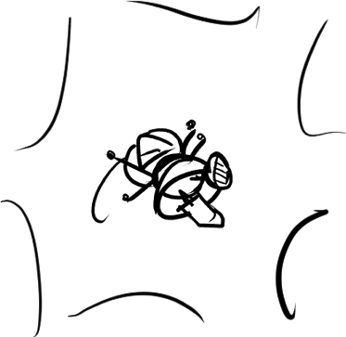
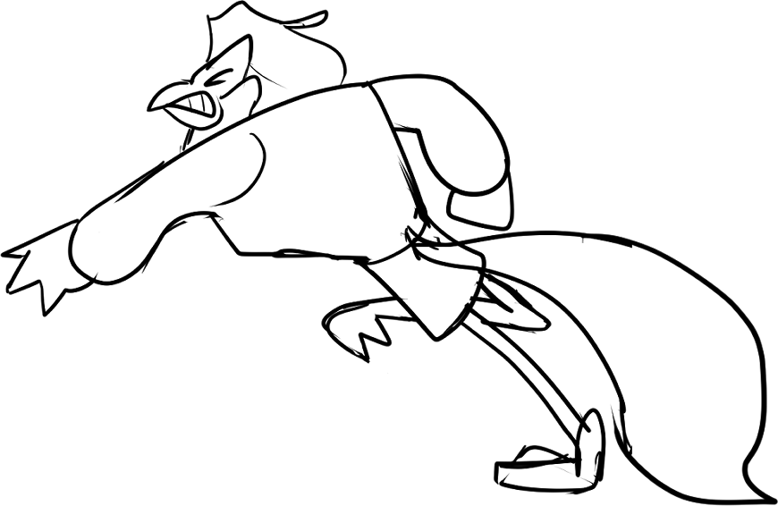
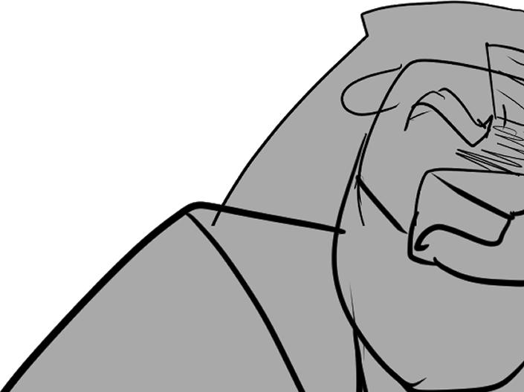
But there was no time for debate. Athos threw Deanna clear over the chasm against her will. The gravity twisted around her, confusing her briefly before she managed to buzz her wings and take flight.
Notes:
SHOW “bg stb3_page 10” WITH “stb3_page 10_Lethabo” and “_athos” / WIPE LEFT “stb3_page 0_deanna” / SHOW TEXT.

Slide 12
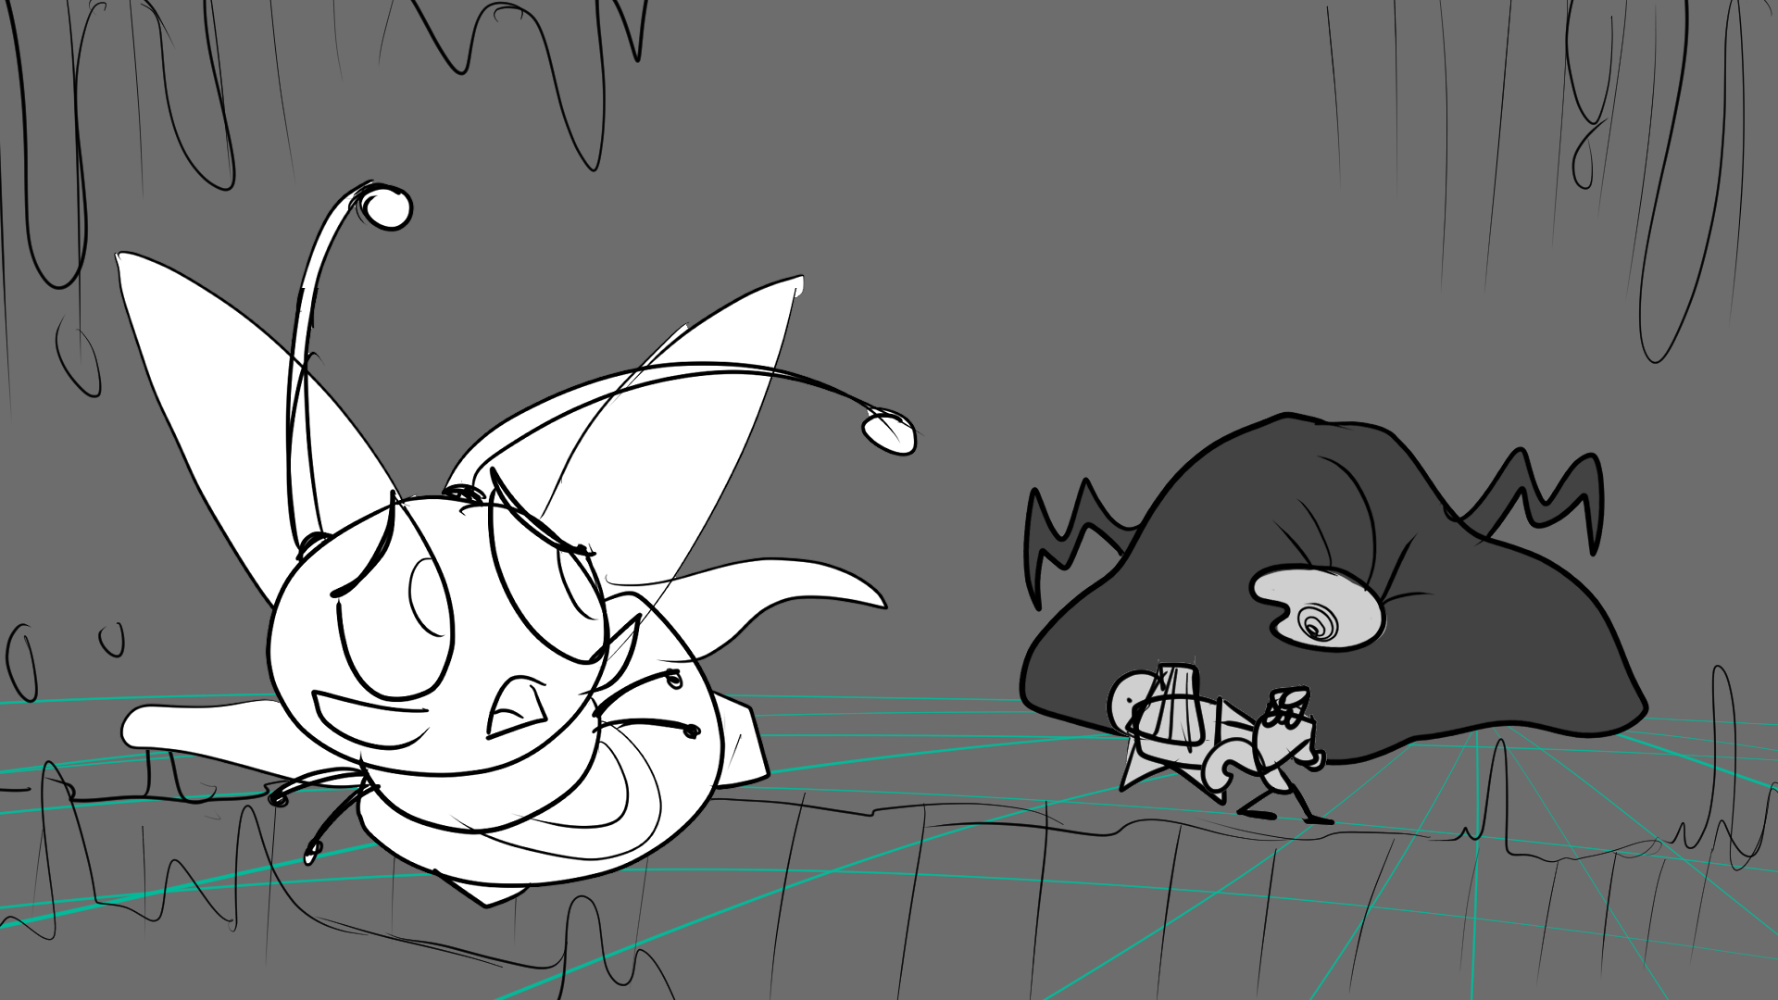
Athos was right. Deanna managed to fly through the warped gap safely. Yet, as she looked back, her stomach twisted up. Athos and Lethabo bravely stood their ground as the Smeared towered over them!
Notes:
SHOW “bg stb3_page 11” / SHOW TEXT.

Slide 13
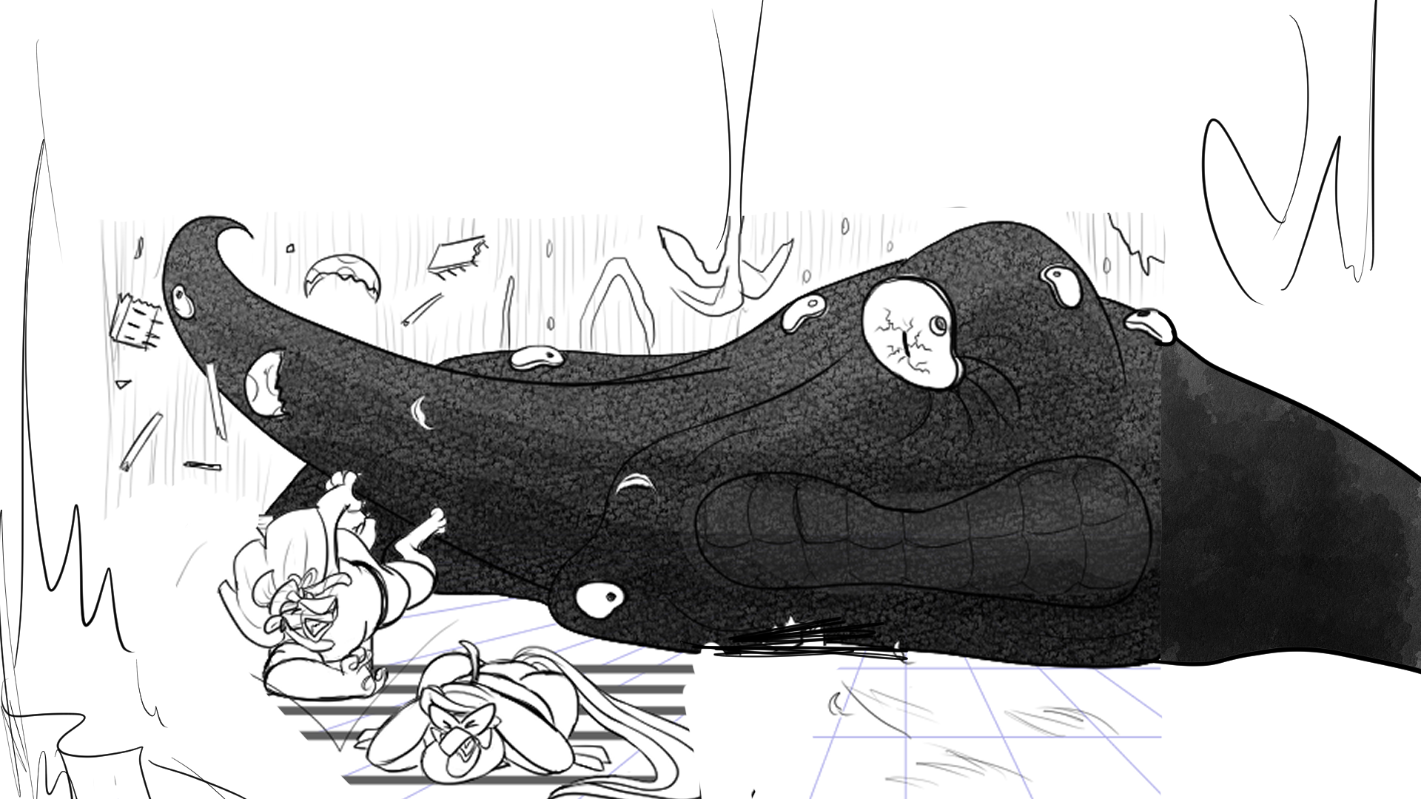
Brave as they were, they were still no match for the eldritch Smeared. With one swipe of its tendril, the Smeared pushed Lethabo off his feet, destroying his shield in the process!
They were about to get smushed like bugs!
Notes:
SHOW “bg stb3_page 12” / SHOW TEXT.

Slide 14
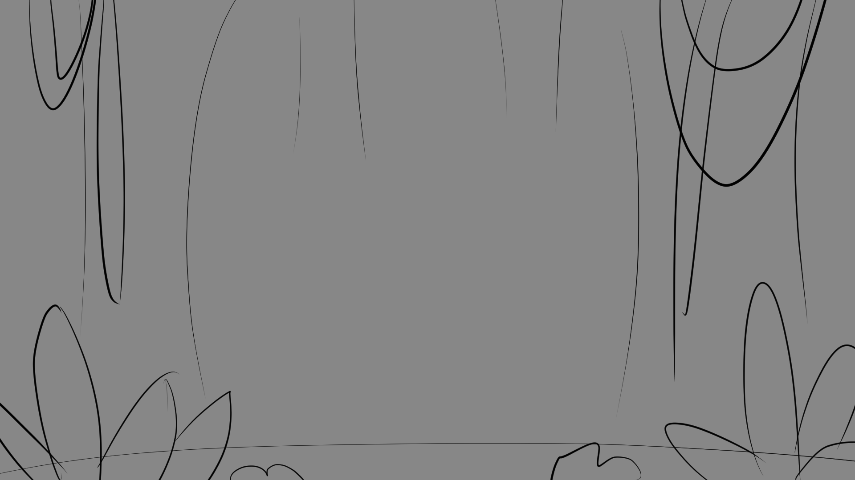
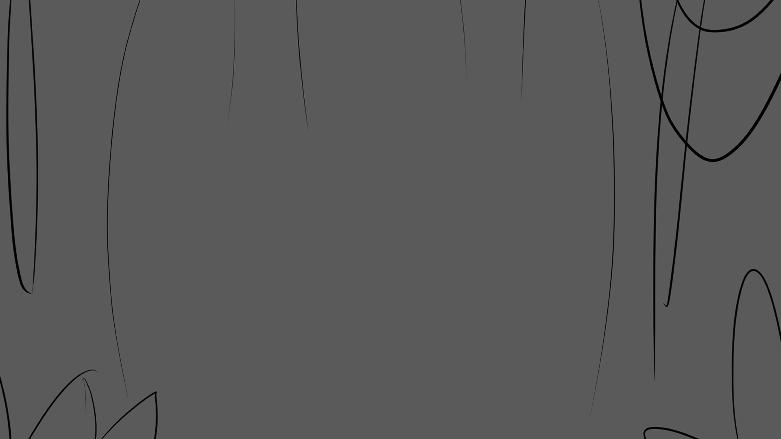
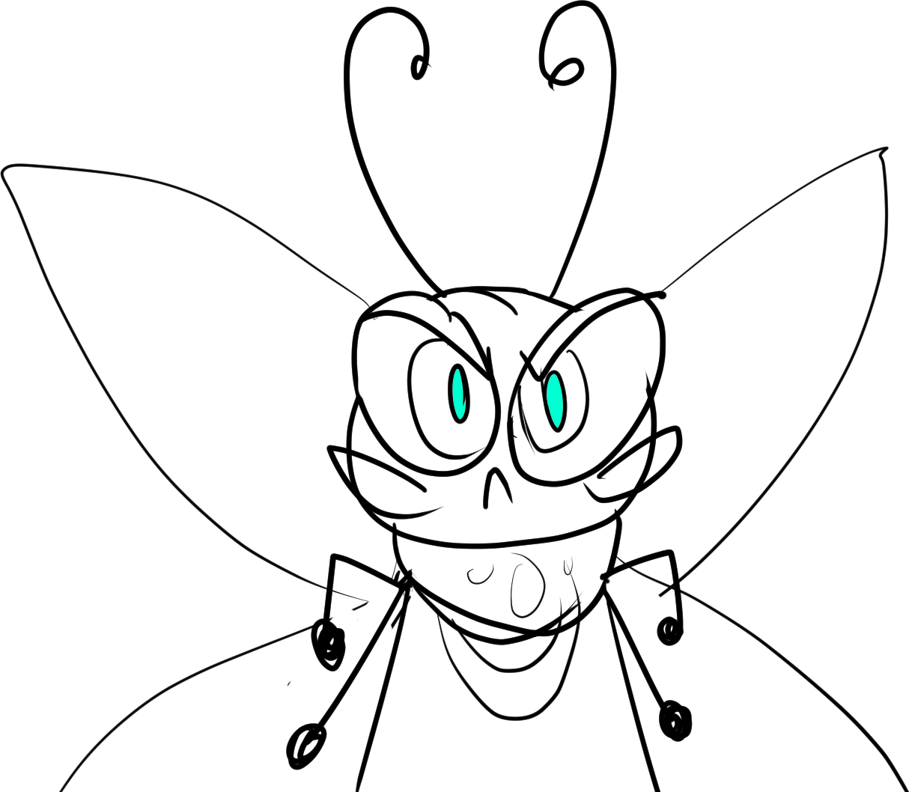
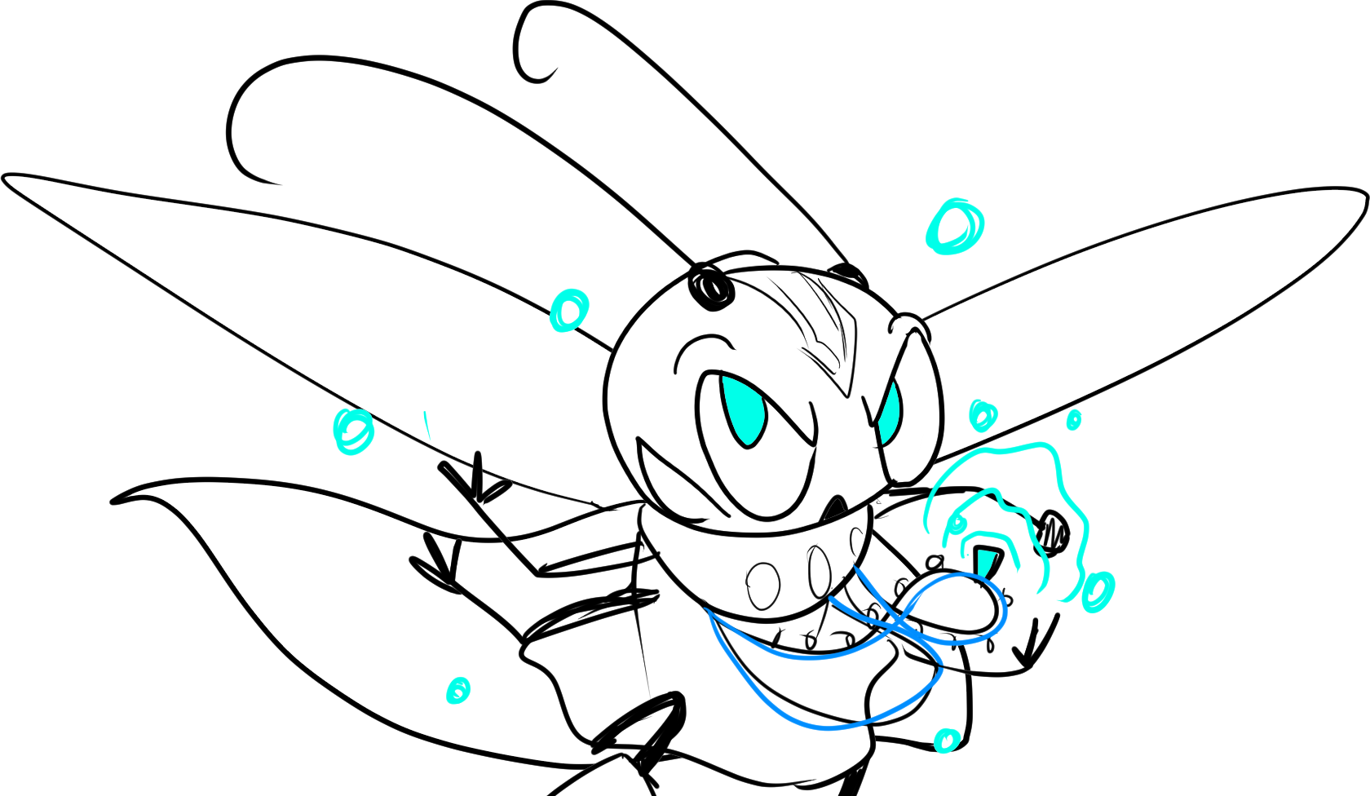
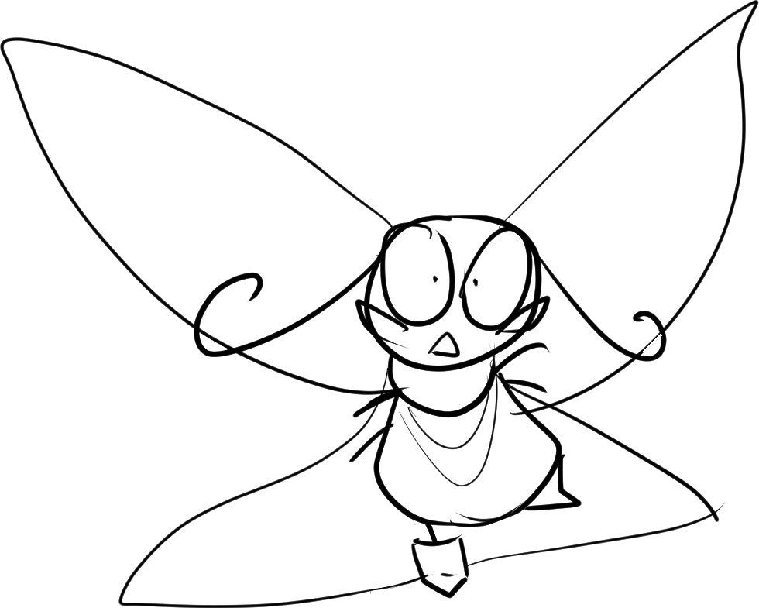

Deanna hovered, hesitant. Yes, she had a duty as a bard to usher in world peace with the hero’s story, but could she really leave behind her friends? The only two animals in the world who accepted her as she was?
Aesop magic pulsed inside Deanna like a beating heart. Her eyes glowed teal as she sung a poem. One of the tokens of her necklace began to radiate, when finally, she summons forth….
No. No she would not. She ran away so many times before, but not today! Her friends need help!
…a golden lyre!
Notes:
SHOW “bg stb3_page 13” WITH “stb3_page 13_deanna 1” / SHOW TEXT / FADE TO “stb3_page 13_bg zoom in” WITH “stb3_page 13_deanna 2” / SHOW TEXT / ANIMATE TO “stb3_page 13_deanna 3” / SHOW TEXT / FADE IN “stb3_page 13_lyre” / SHOW TEXT.

Slide 15
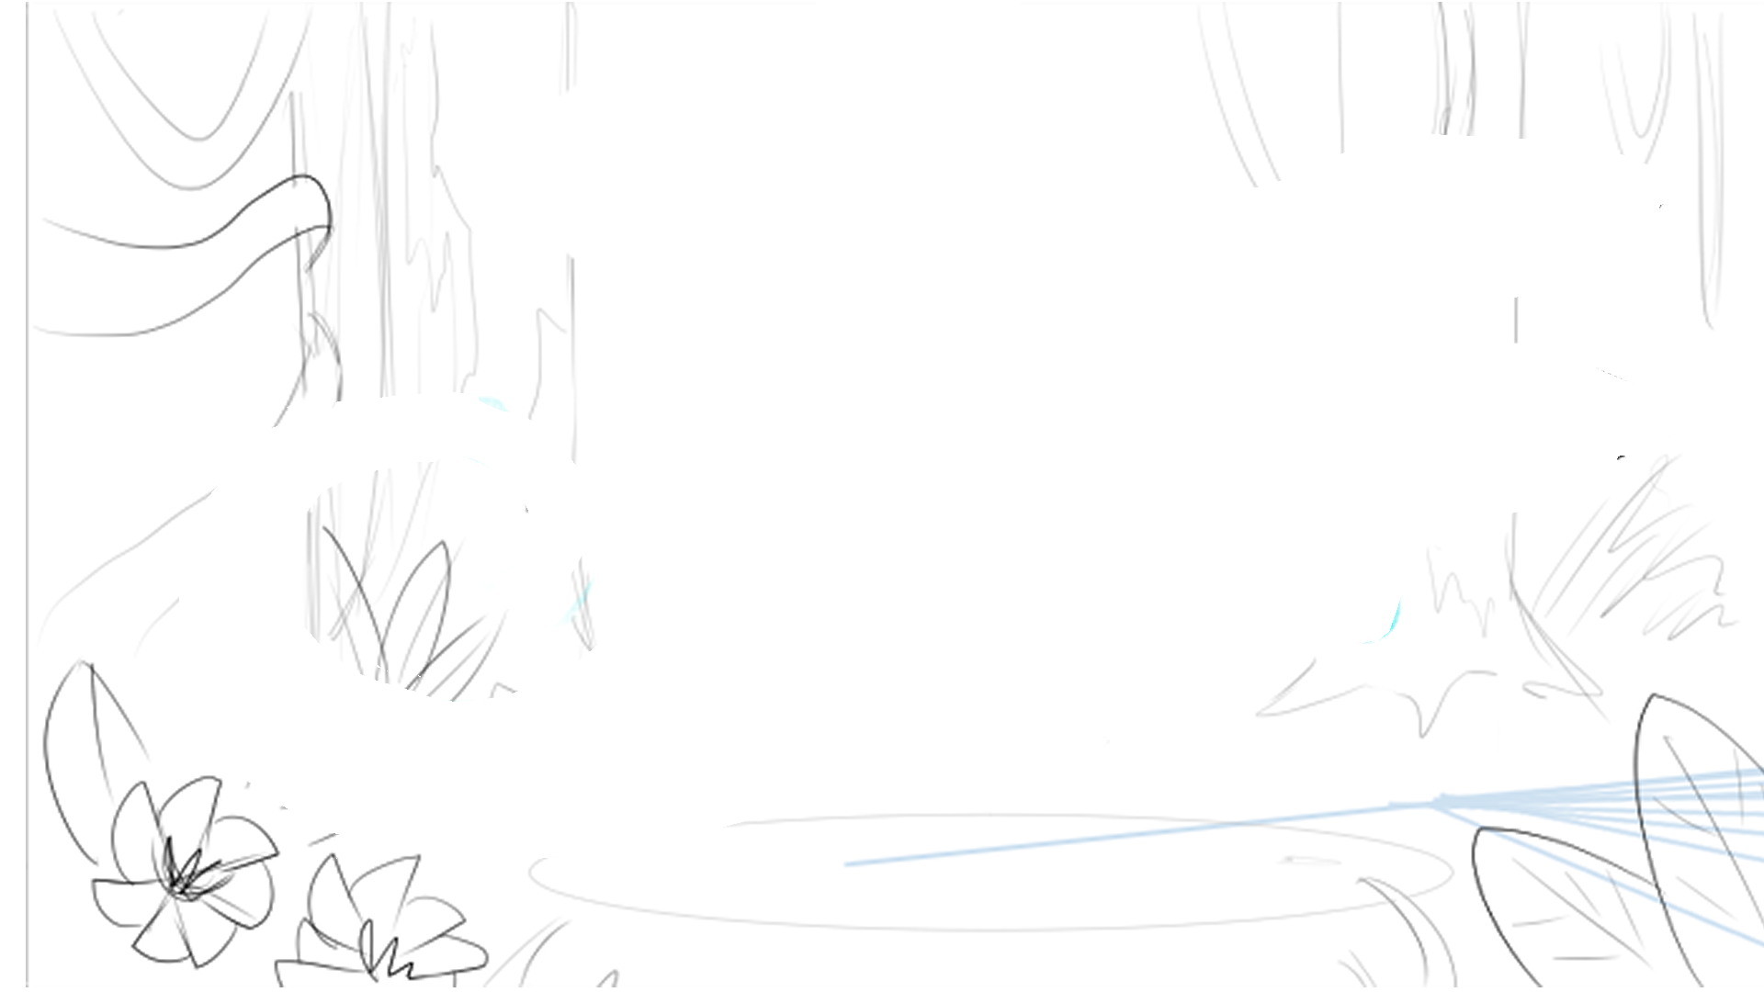
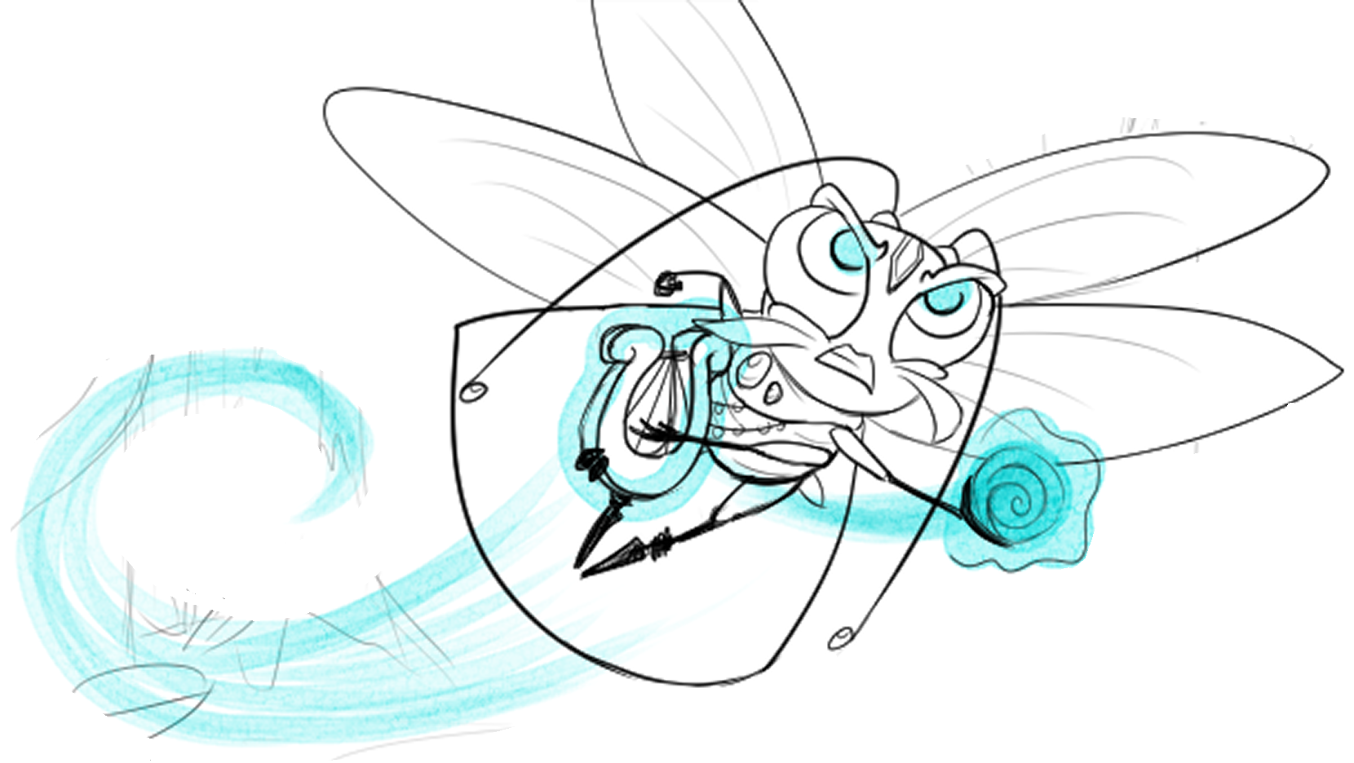

Deanna powered up her Aesop and spoke another poem in her native tongue. Teal light fluttered around her, her cape whipped about, she held her breath, and—!
Notes:
SHOW “bg stb3_page 14” WITH “stb3_page 14_deanna 1” / SHOW TEXT / ANIMATE FROM ”deanna 1” to “deanna 2”.

Slide 16
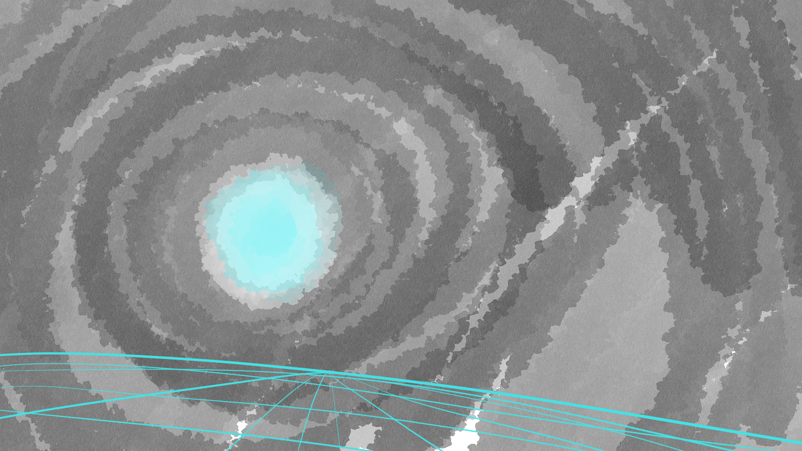
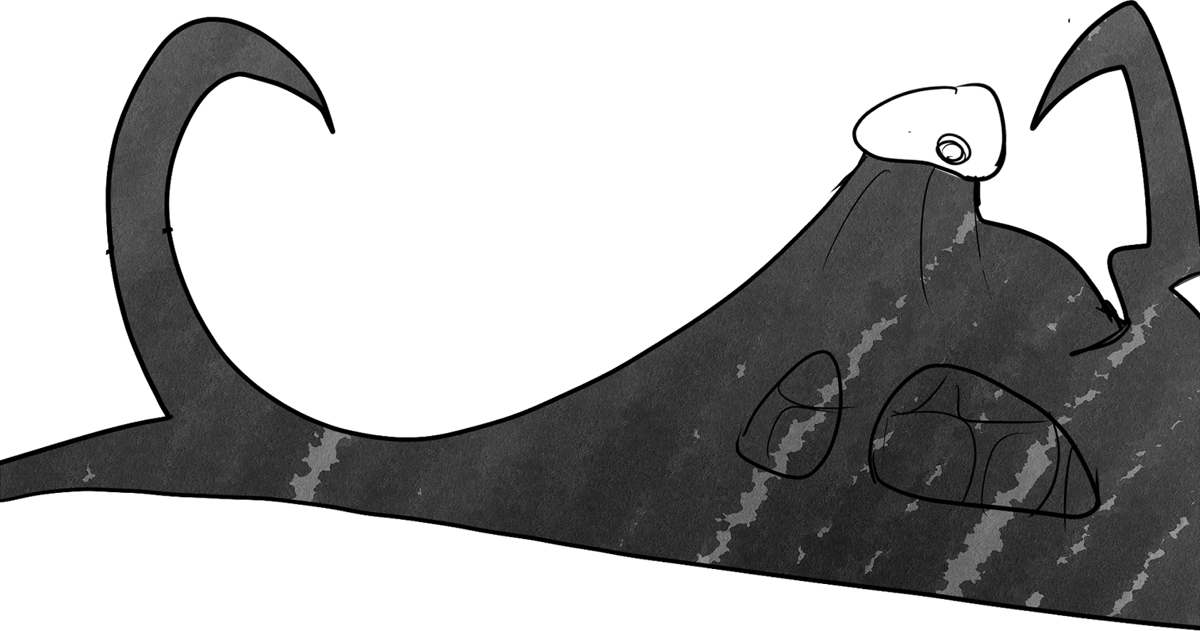


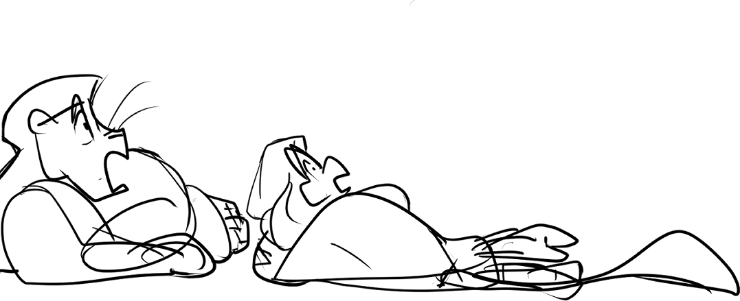
Lethabo and Athos dropped their jaws at the sight of her hidden might. The Smeared showed a split second of morbid fear!
Deanna pushed the Smeared back with a magical shield of Aesop!
Notes:
SHOW “bg stb3_page 15” / ANIMATE IN ”stb3_page 15_smeared” THEN “_lethabo_and_athos” THEN “_deanna” THEN “_shield” WITH SOUND / SHOW TEXT.

Slide 17

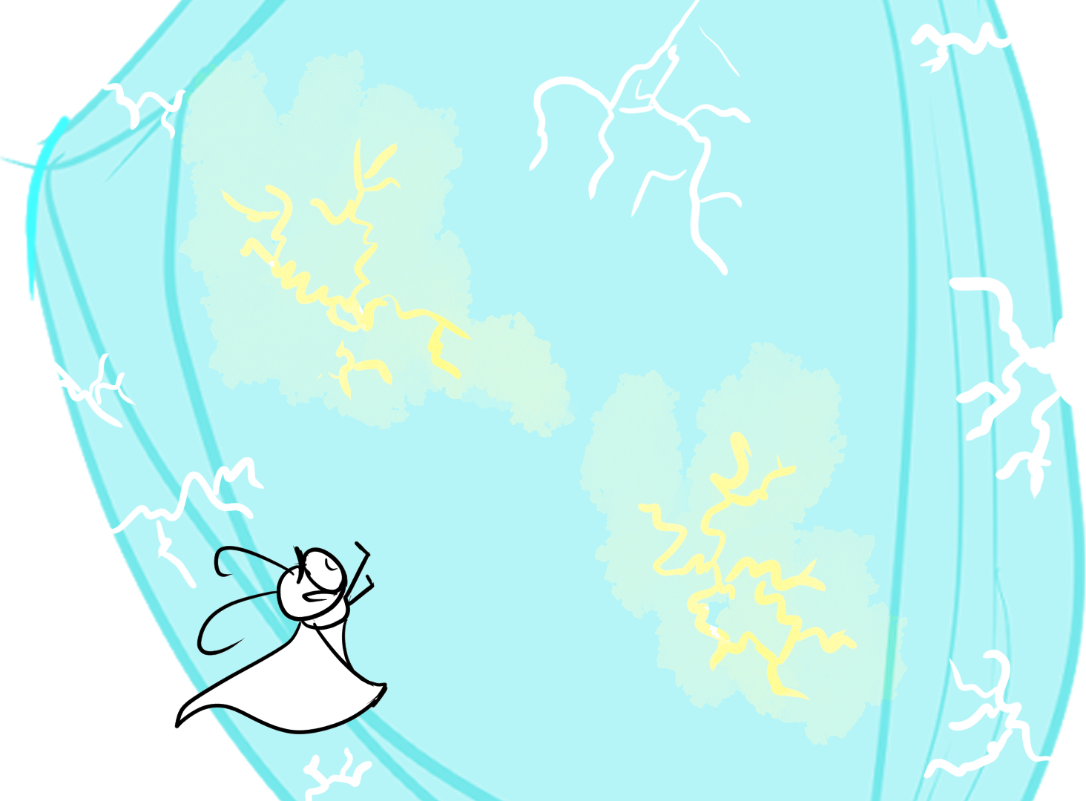
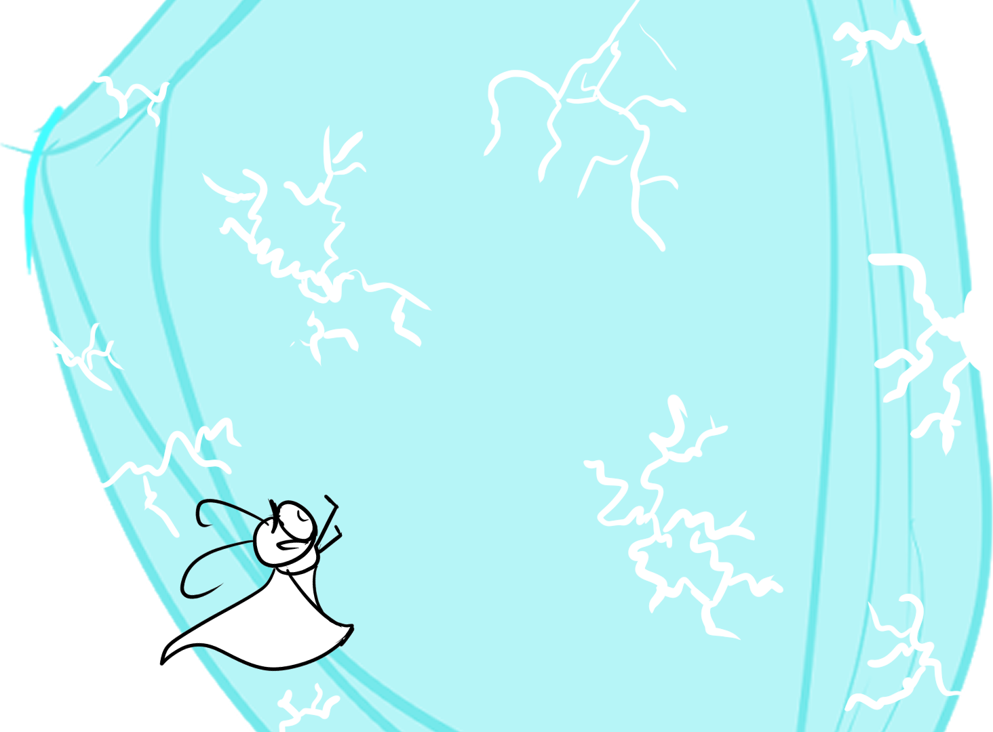
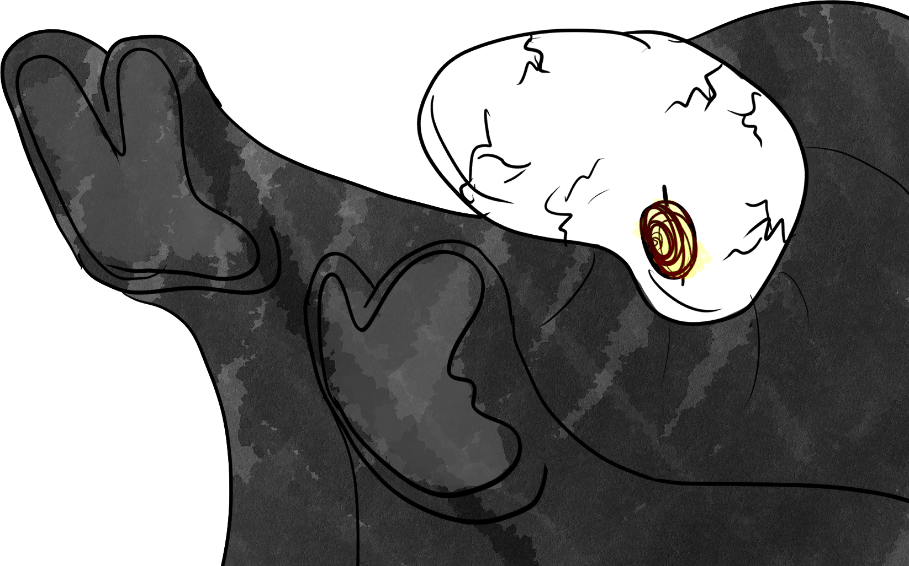
But the Smeared fought back! Despite Deanna’s magic sizzling its body, the monster pushed against her shield with yellow magic—making it crack!
Notes:
SHOW “bg stb3_page 16” WITH “stb3_page 16_shield 1” / DELAY WIPE IN FROM RIGHT “stb3_page 16_smeared” THEN ANIMATE “_shield 1” TO “shield 2” / SHOW TEXT.

Slide 18
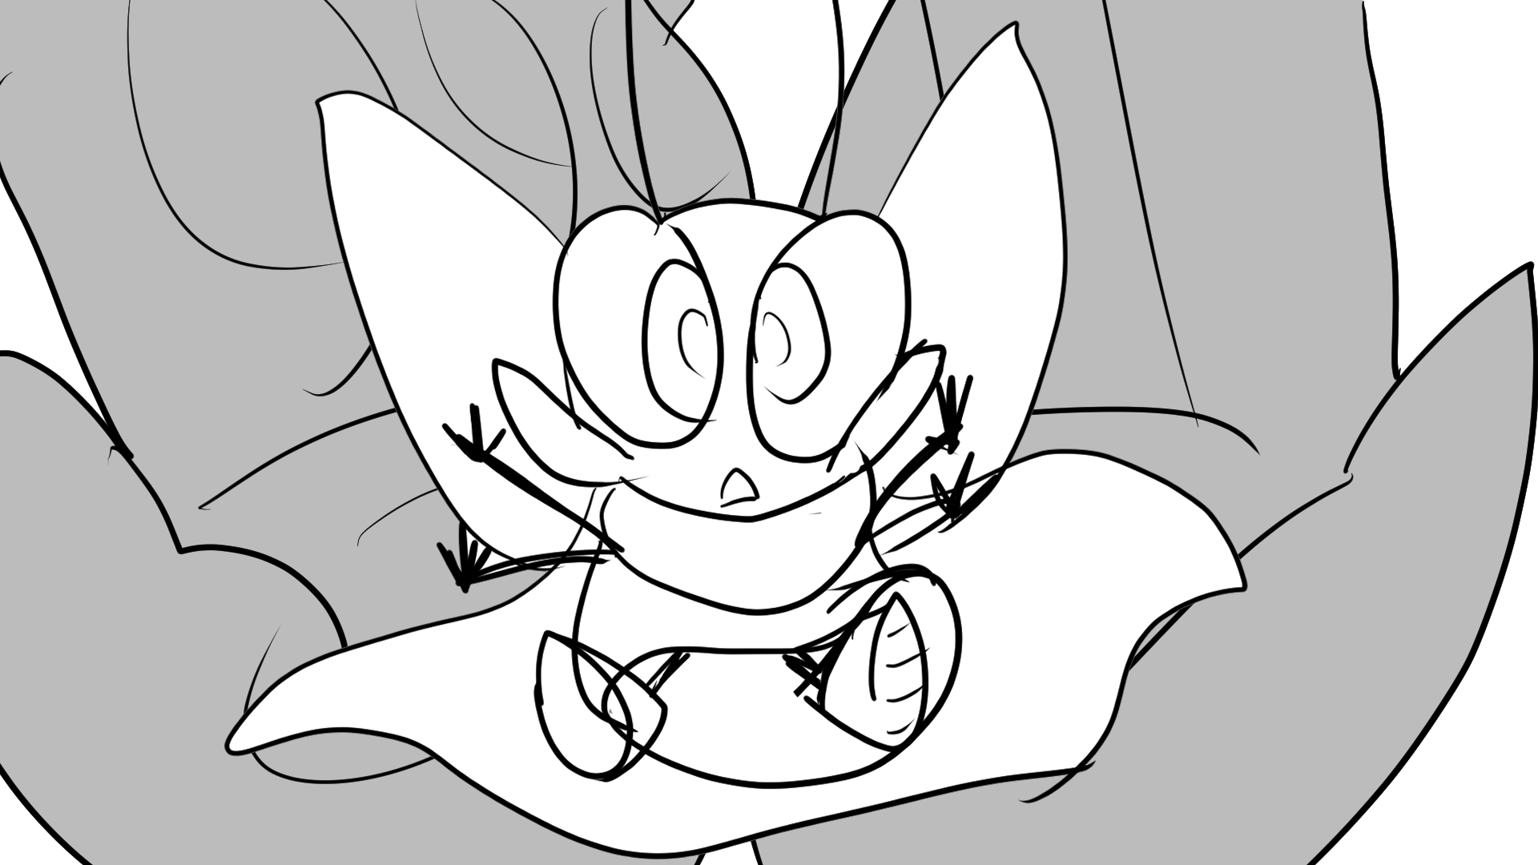

How silly she was to think she could save her friends! She was no hero; she was just a small, silly cockroach! What business has she even trying?
Deanna tried with all her might to push back, buzzing her wings like mad, but the Smeared was so strong!
A desperate tear ran down her face.
Suddenly, it felt like the weight of the world was lifted off her shoulders! Deanna felt a warmth hold her up from behind.
Notes:
SHOW “bg stb3_page 17” WITH “stb3_page 17_deanna 1” / SHOW TEXT / ANIMATE TO “_deanna 2” / SHOW TEXT / CONTINUE onto next slide for part 2 of page 17.

Slide 19






Athos
Deanna
Lethabo
“We got your back, topolina!”
“Give it your all!”
To Deanna’s shock, Lethabo and Athos held her up!
“Right!”
Notes:
SHOW “bg stb3_page 17” / START WITH “stb3_page 17_deanna 3” AT CENTER with “stb3_page 17_lethabo and athos behind” CENTERED BEHIND / ANIMATE “stb3_page “stb17_deanna 3” TO below and semi-off-screen so “_lethabo and athos behind” is visible / SHOW TEXT / WIPE IN “stb3_page 17_athos action pop” WITH TEXT / WIPE IN “stb3_page 17_Lethabo” WITH TEXT / WIPE IN “stb3_page 17_deanna action pop 1” / ANIMATE TO “_deanna action pop 2” / SHOW TEXT.

Slide 20




Deanna
The Smeared’s body chipped away from her power. It tried, oh how it tried to fight back, but even its mask was cracking even more from the pressure!
Her little body burned brighter and brighter with teal light. Lethabo and Athos squeezed their eyes shut as they dug in their heels and kept her steady.
“Yaaaaaaaah!”
They pushed and pushed and pushed until, until, until…!
With a small yet mighty cry, Deanna pushed back with all her might.
Notes:
SHOW “bg stb3_page 18” WITH “stb3_page 18_bg gray” OVER IT / WIPE IN “stb3_page 18_deanna action pop” THEN “stb3_page 18_smeared action pop” / WIPE AWAY “_deanna action pop” AND “_smeared action pop” DISSOLVE “stb3_page 18_bg gray” / SHOW TEXT / WHITE OUT TO TRAILER.

Slide 21
END OF Storybook Mode 3
TRANSITION TO Trailer

Slide 22
Lethabo
“Dialogue.”
Deanna
“Dialogue.”
Athos
“Dialogue.”
Narration.

